Slide 1
Qualifications
for Data Analyst
in California
Aoran Zhang
Yi Meng
Xiaofei Li
University of California Davis

Slide 2


Motivation
1．
2．
3．

Slide 3
Project Procedure
1．
2．
3．
4．

Slide 4
Skills Requirements
Web
Scrapping
Basic
Requirements
Data source and cleaning

Slide 5
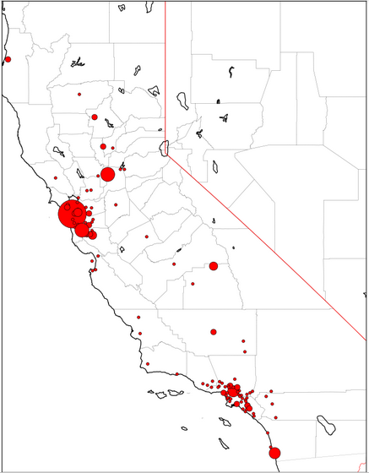
Skills Requirements
Web
Scrapping
Basic
Requirements
SAC
SF
PA
LA
SD

Slide 6
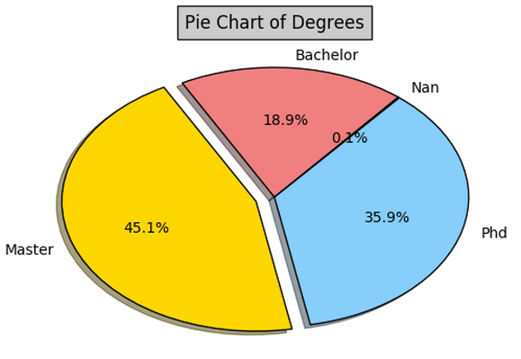
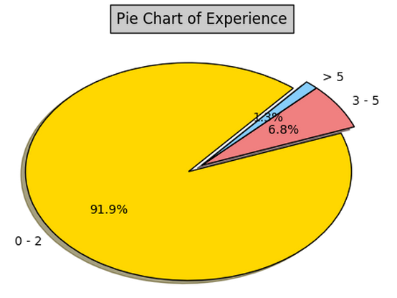
Skills Requirements
Web
Scrapping
Basic
Requirements
Pie Chart of Education Background
Pie Chart of Working Experience

Slide 7

Skills Requirements
Web
Scrapping
Basic
Requirements
Natural Language Processing
Stem
lemmatize
lDF Calculation

Slide 8
Skills Requirements
Web
Scrapping
Basic
Requirements
IDF of Required Skills
skills | idf | skills | idf
r | 1.54 | spark | 4.34
sql | 1.86 | mysql | 5.4
excel | 2.12 | java | 5.42
microsoft | 2.61 | spss | 5.79
tableau | 2.61 | hive | 5.87
python | 2.67 | sas | 6.01
access | 2.68 | matlab | 6.12
stata | 3.64 | vba | 6.3
oracl | 3.64 | pig | 6.37
hadoop | 4.15 | sqlserver | 8.31

Slide 9
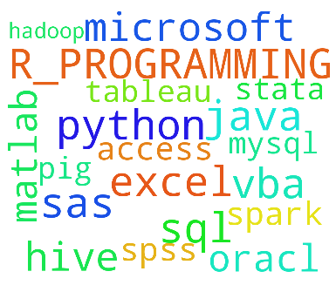
Skills Requirements
Web
Scrapping
Basic
Requirements
Word Cloud for Required Skills

Slide 10
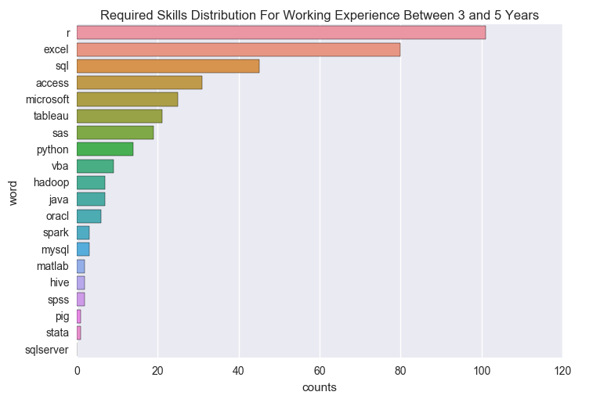
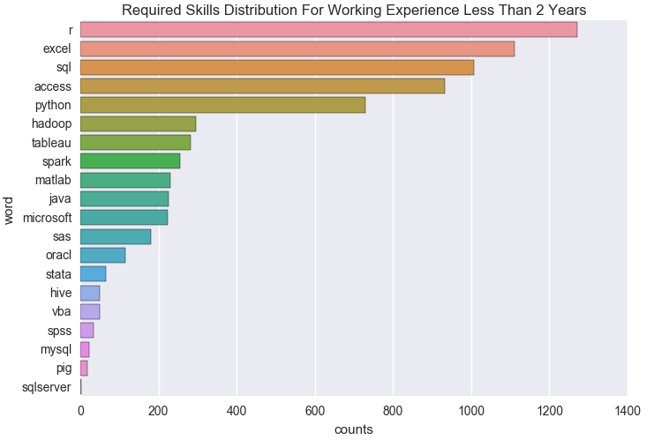
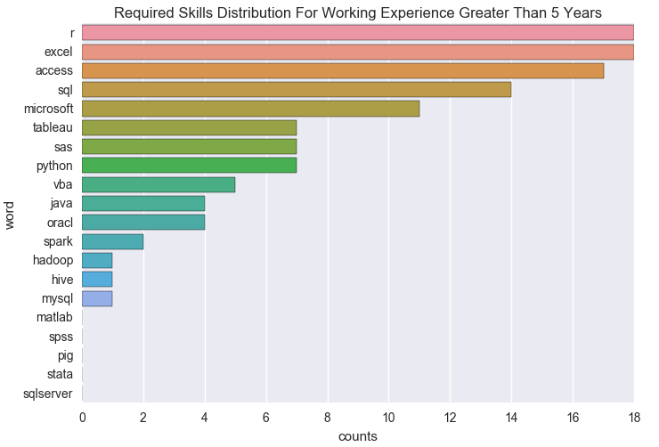
Skills Requirements vs Working Experience
Web
Scrapping

Slide 11
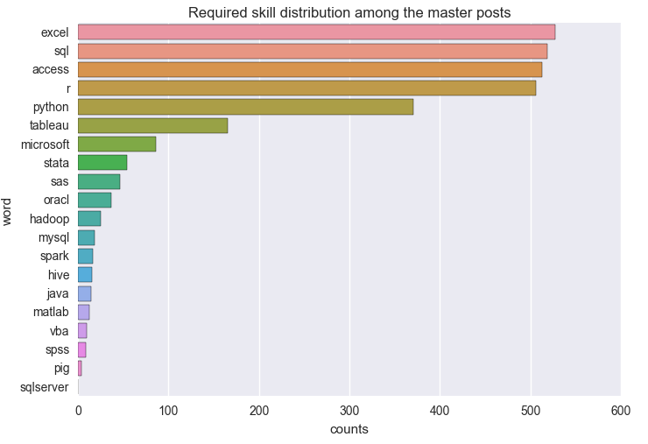
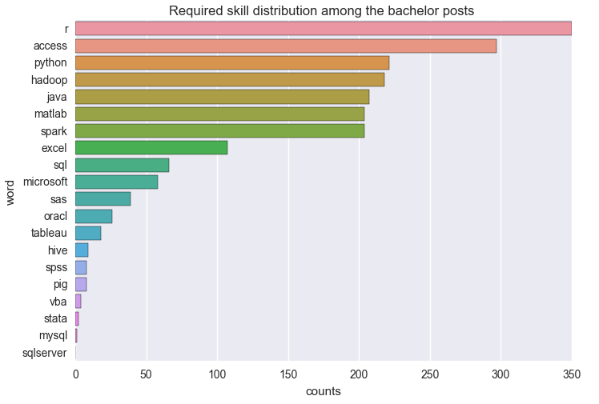
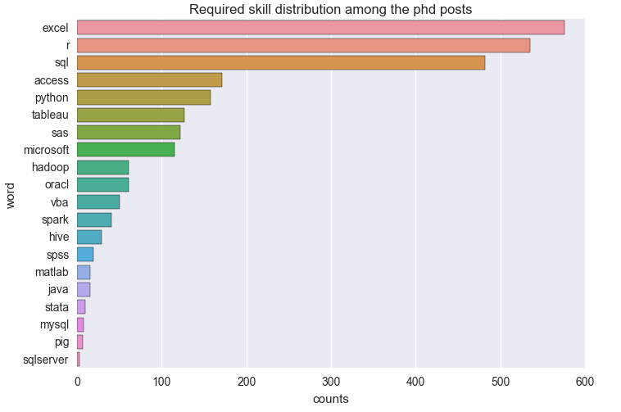
Skills Requirements vs Education Background
Web
Scrapping

Slide 12

Method
Generalization

Slide 13

Method Generalization
Guide the choice of employment place
Key factors to improve competitiveness
Generalize to analyze big data
城市收入水平，建设水平，行业发展前景对毕业生选择就业城市有一定影响

Slide 14
Aoran Zhang Yi Meng Xiaofei Li
Thank you!
University of California, Davis

